Slide 1
Achieving better model Generalization
Pedro Paulo Boechat Rabello Dutra Pinto

Slide 2
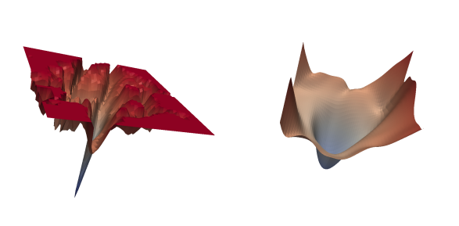
Motivation and problem definition
Image processing field
What are some approaches?
How can loss be a determinant factor?
Notes:
SHARPNESS-AWARE MINIMIZATION FOR EFFICIENTLY IMPROVING GENERALIZATION Pierre Foret ∗ Google Research pierre.pforet@gmail.com Ariel Kleiner Google Research akleiner@gmail.com Hossein Mobahi Google Research hmobahi@google.com Behnam Neyshabur Blueshift, Alphabet neyshabur@google.com
y minimizing loss value and loss sharpness. In particular, our procedure, Sharpness-Aware Minimization (SAM), seeks parameters that lie in neighborhoods having uniformly low loss;
Though our derivation of SAM defines the SAM objective over the entire training set, when utilizing SAM in practice, we compute the SAM update per-batch (as described in Algorithm 1) or even by averaging SAM updates computed independently per-accelerator (where each accelerator receives a subset of size m of a batch, as described in Section 3). This latter setting is equivalent to modifying the SAM objective (equation 1) to sum over a set of independent maximizations, each performed on a sum of per-data-point losses on a disjoint subset of m data points, rather than performing the maximization over a global sum over the training set (which would be equivalent to setting m to the total training set size). We term the associated measure of sharpness of the loss landscape m-sharpness

Slide 3
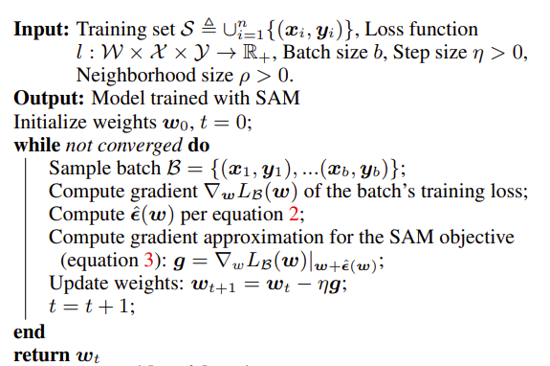
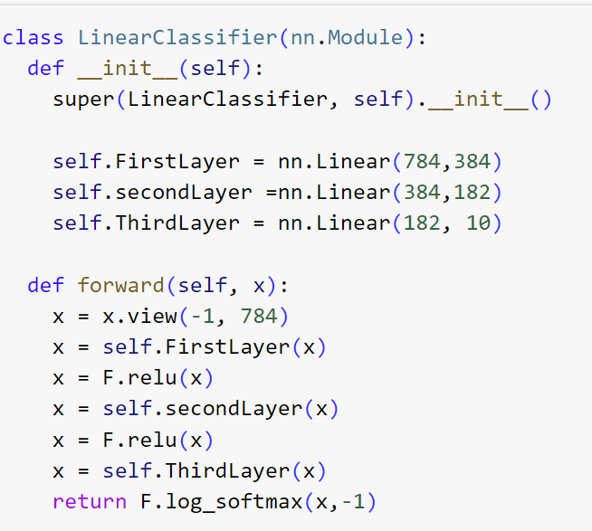
Implementation
Re-implement SAM algorithm
Test two scenarios
Expend and test on novel models

Slide 4
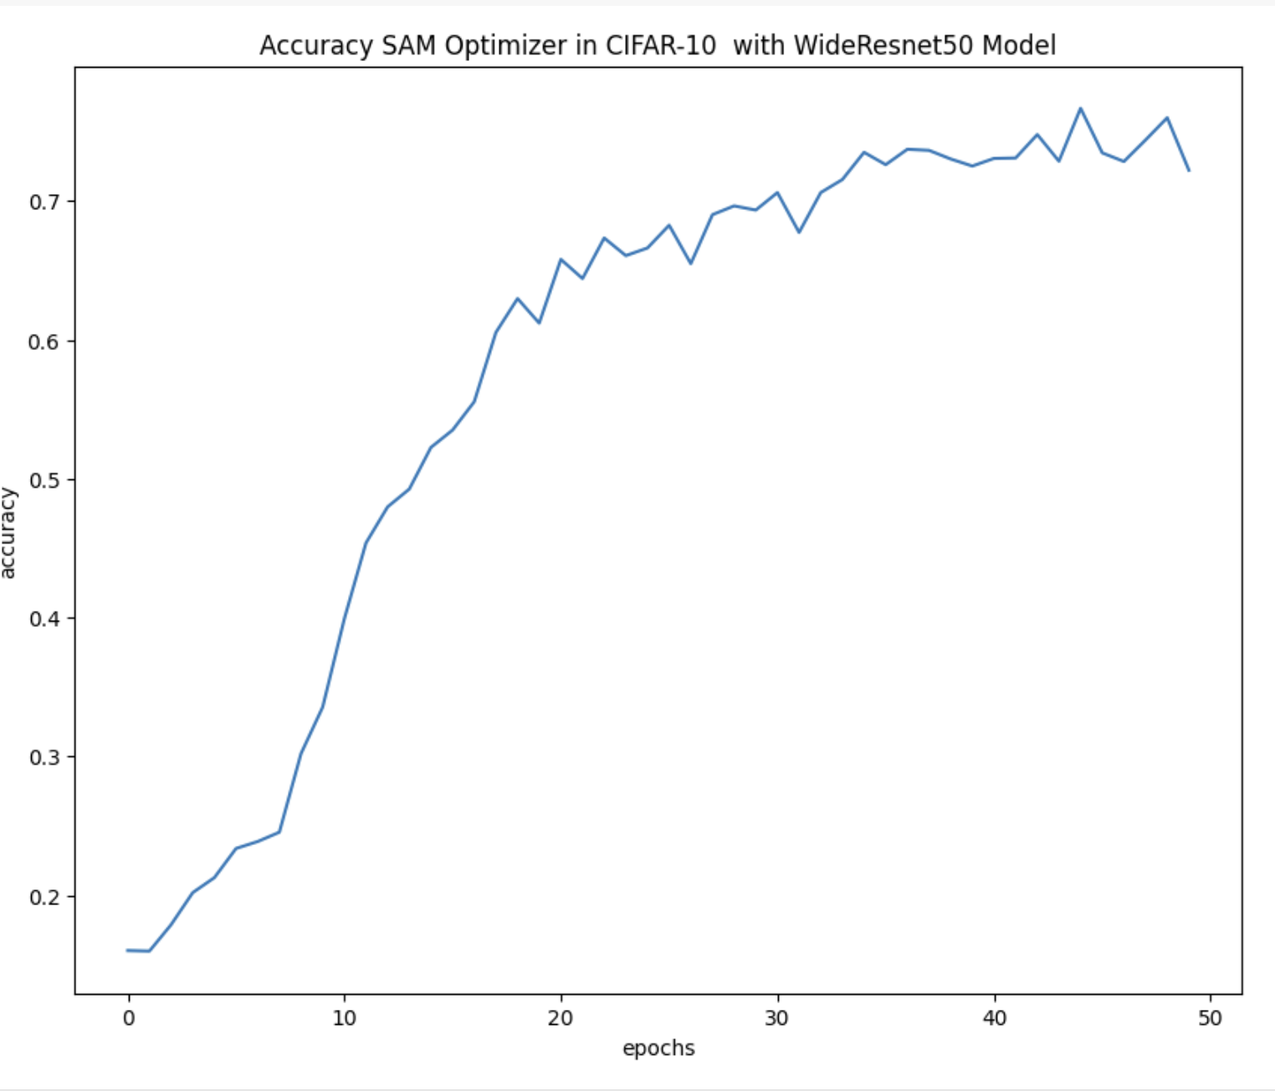
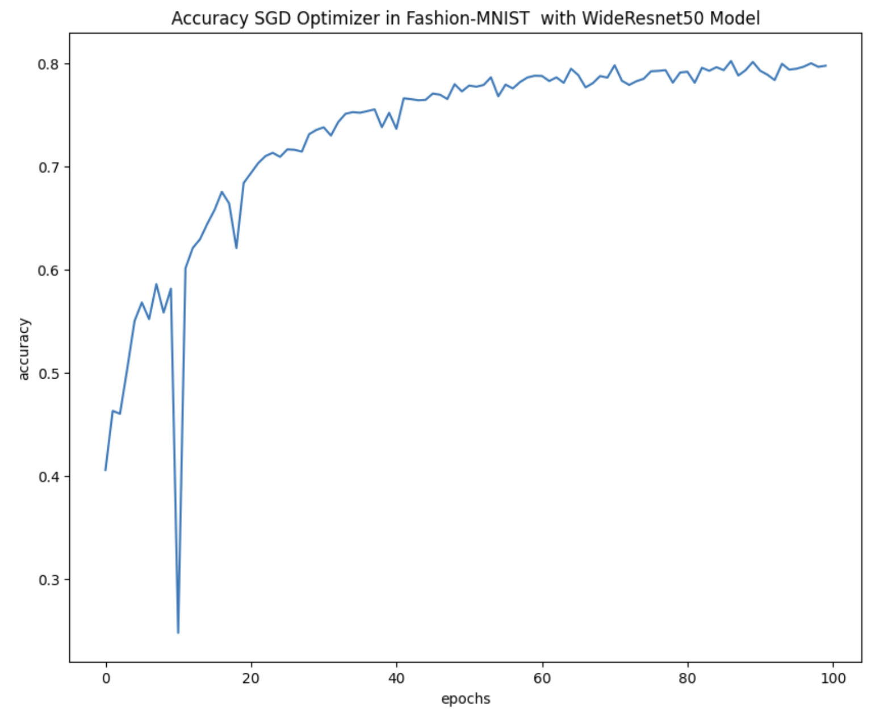
Results for CIFAR with WideResnet50

Slide 5
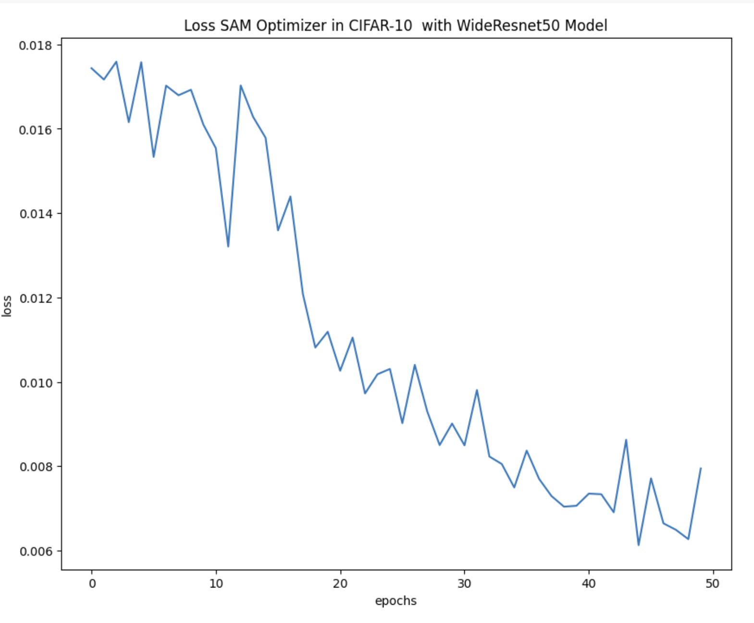
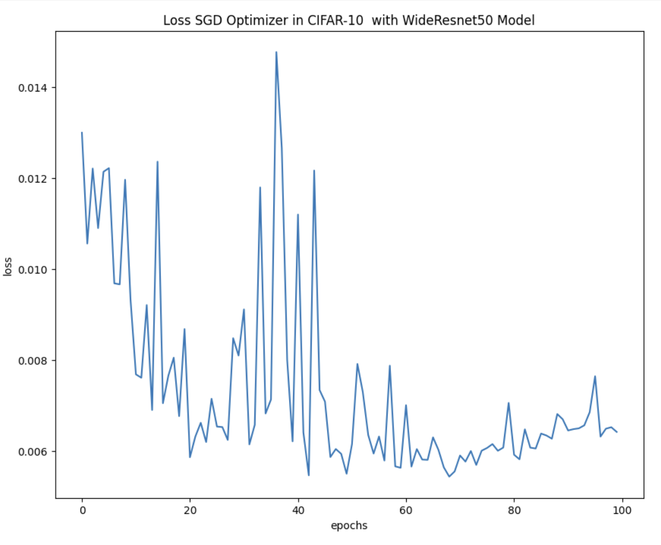
Loss in CIFAR-10 with WideResnet50

Slide 6
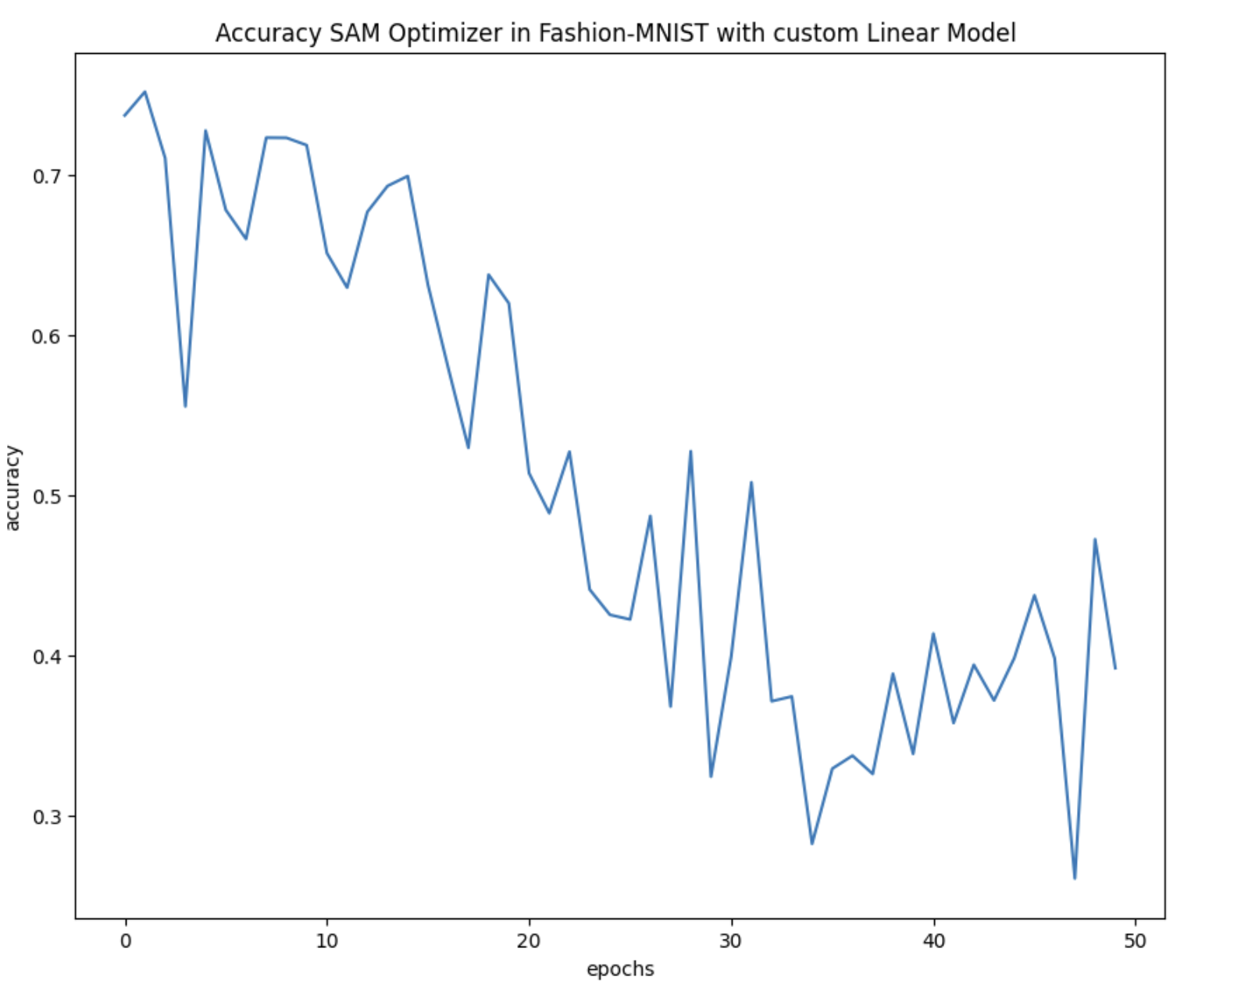
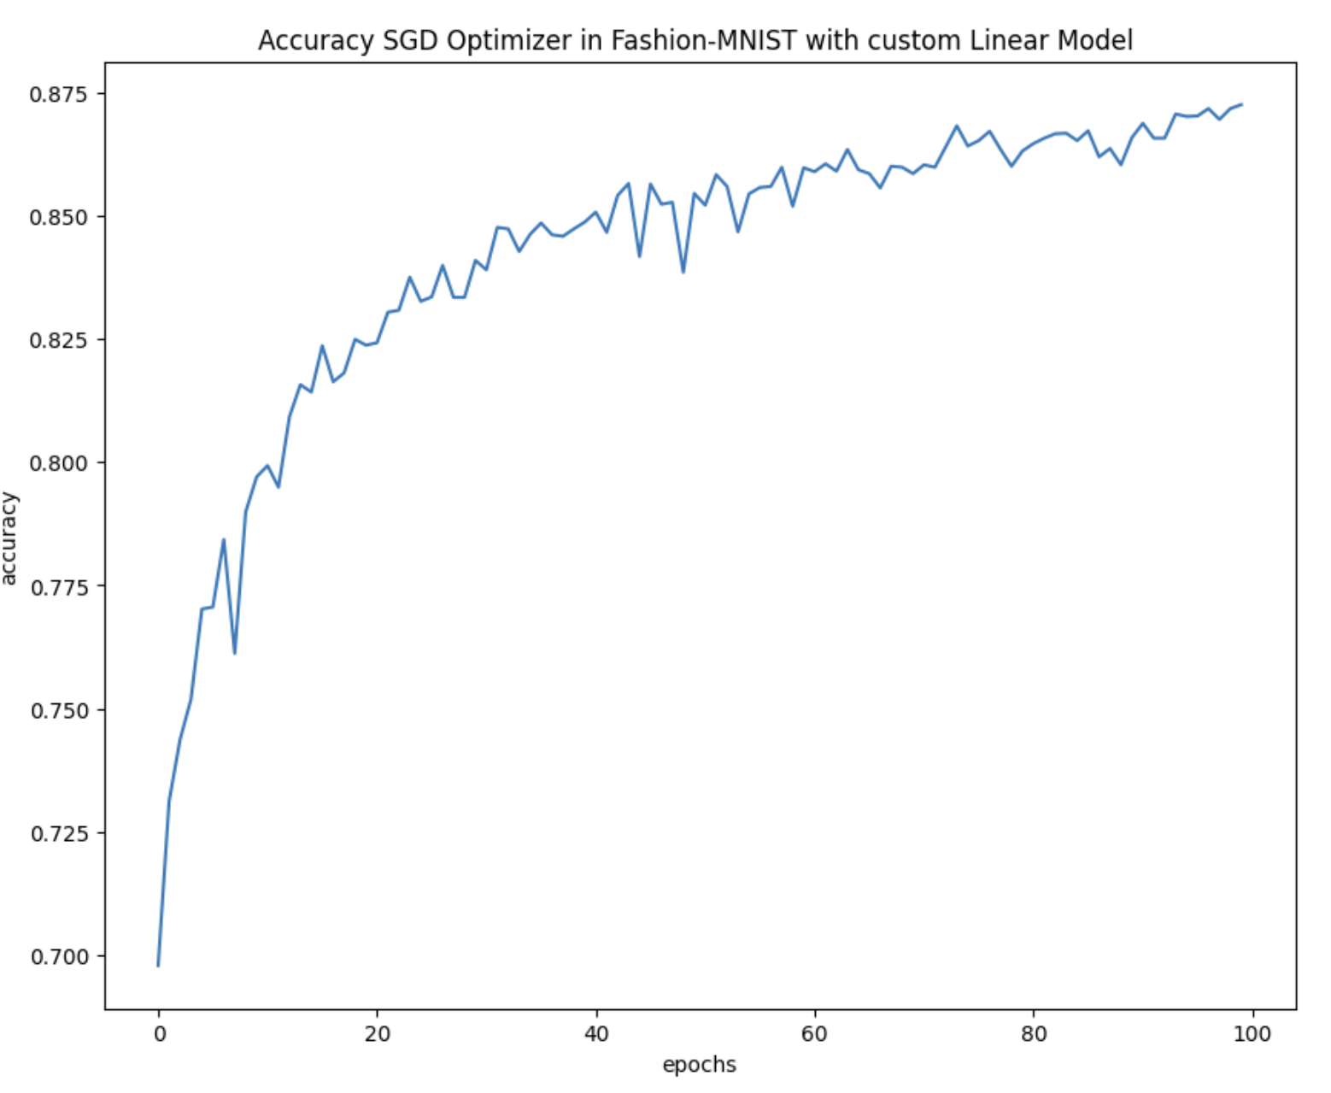
Results for Fashion-MNIST with custom Model

Slide 7
Main Takeaways and Future Directions
SAM seems promising and delivers in generalizing models, as their loss becomes smoother
There is still more tests and research to be done!

